Slide 1
Butterfly Effect Theory
Dynamic Systems
2024-01
By Mohammad Mashreghi

Slide 2
Index
Introduction
Dynamical Systems
Attractors
Lorenz Attractor
Strange Attractor
Chaotic Attractor
Applications
Quotes Inspired from the theory
Movies
Magazine

Slide 3
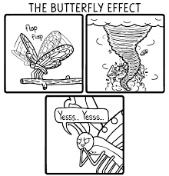

Introduction
Butterfly Effect :
It suggests that something as tiny as the flap of a butterfly's wings in Brazil, could trigger a tornado.

Slide 4
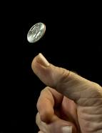
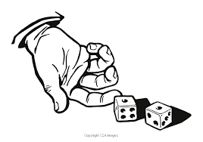
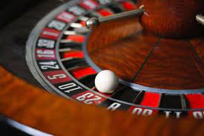
Introduction
Every day we experience things that seem to us random, chaotic and unpredictable.
From flipping a coin, to rolling a dice , playing the lottery , even trying guess the weather.

Slide 5
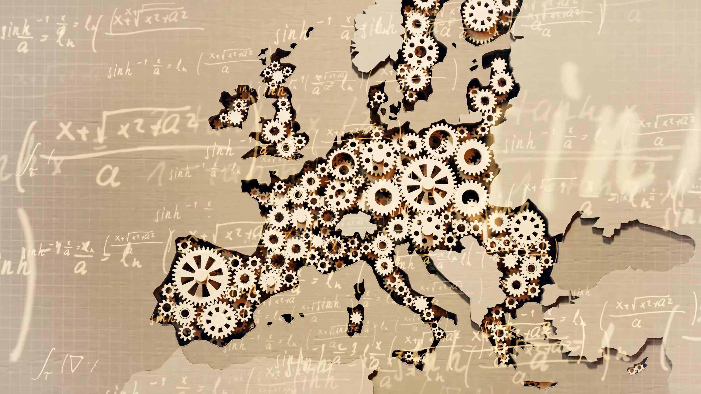

Introduction
One of the fundamental assumptions of classical physics is that the laws of nature are deterministic.
In other words: if you know absolutely everything there is to know about a system (even a really complex one) then we can, just like clockwork, predict the future of that system.
If this intellect were vast enough to submit the data to analysis… ,then the future, just like the past, would be present before its eyes(P. S. Laplace)

Slide 6
Introduction
How can these two things be compatible?
And if we have enough data and the right models, can we really
PREDICT THE UNPREDICTABLE?

Slide 7
Introduction
In everyday language, we use the words ‘Random’ and ‘Chaotic' as if they mean the same thing.
But in mathematical: ‘chaos’ refers to systems that are extremely sensitive to changes in their initial conditions.
Chaotic Systems: Deterministic with no random which underlying patterns and rules, but unpredictable on long term because they are very complex and sensitive.

Slide 8
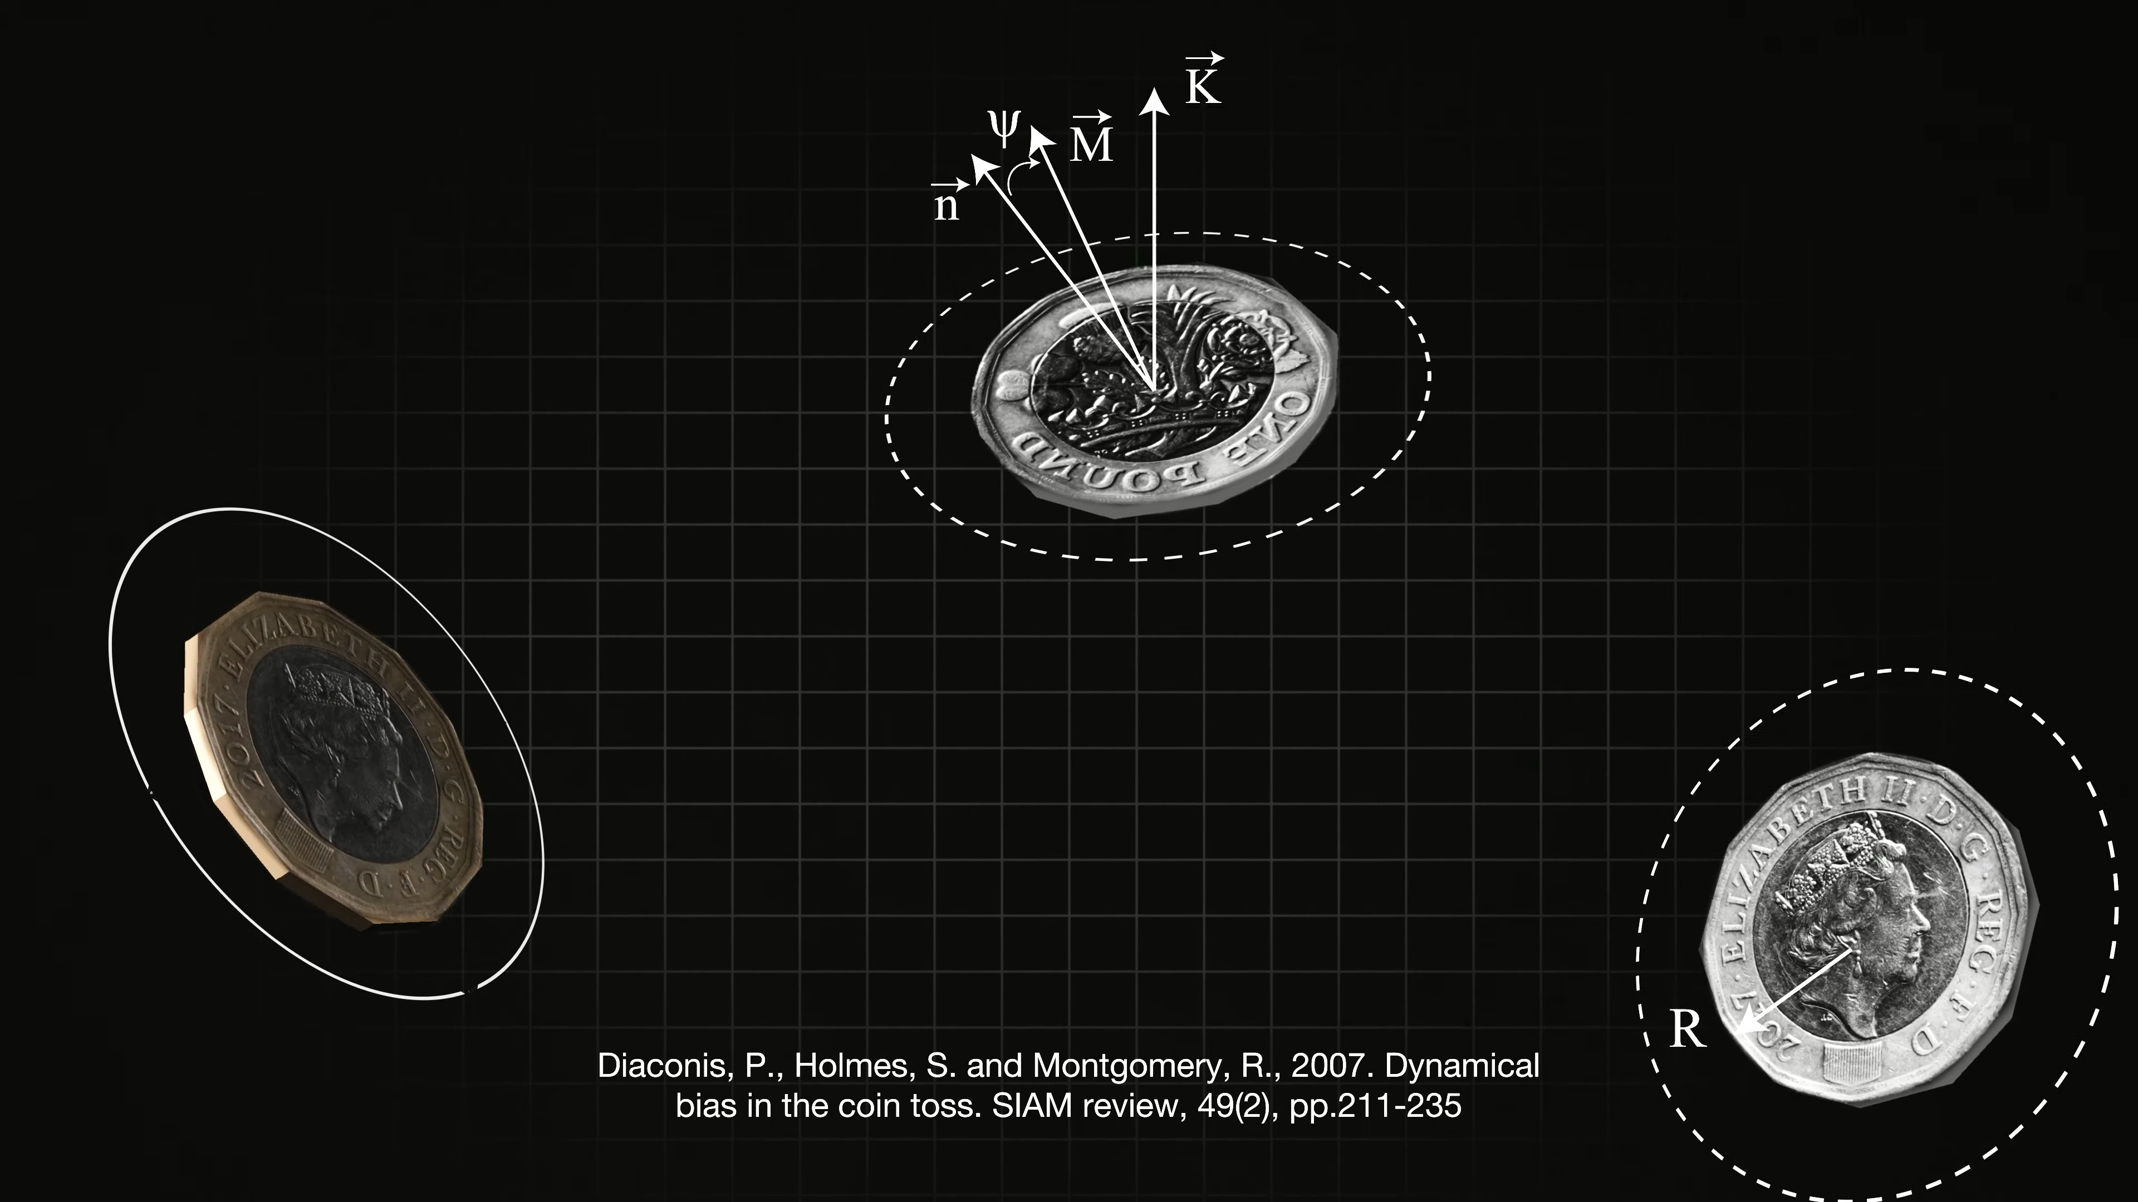
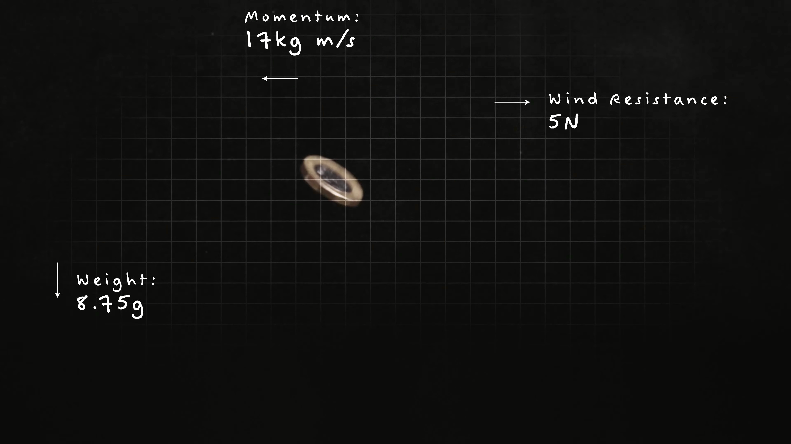
Introduction
Example: Flip a coin
We use it to help us in our decisions, but according to Newton’s law of Emotion

Slide 9
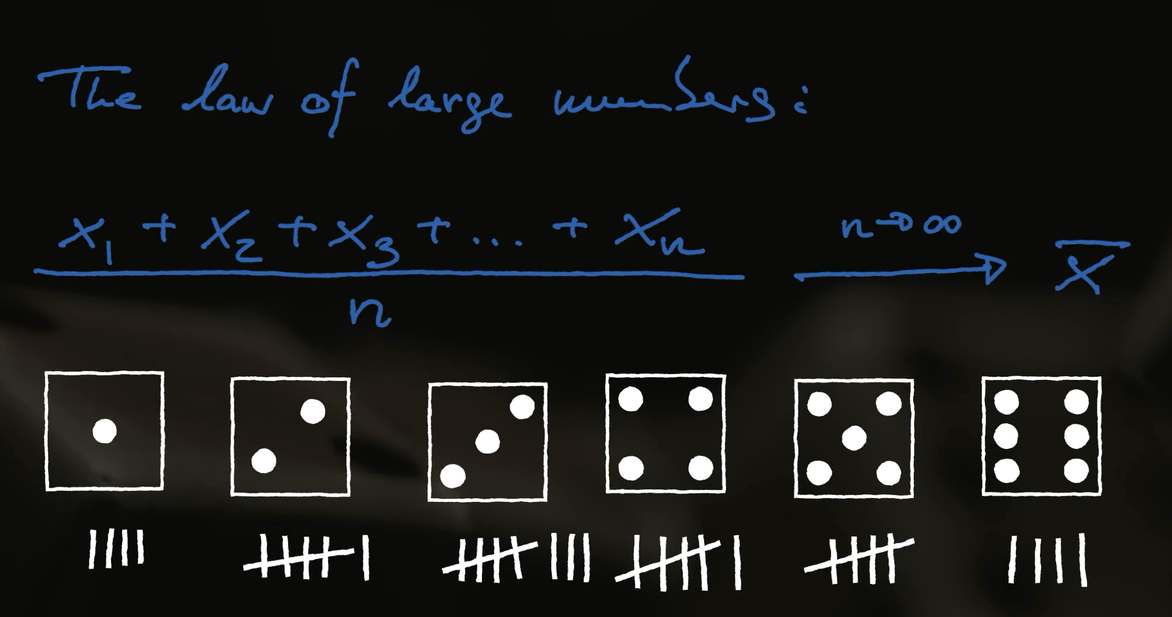
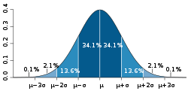
Introduction
Even when we can’t predict it well, we can use LLN.
Law of Large numbers (LLN): is a mathematical theorem that states that the average of the results obtained from a large number of independent and identical random samples converges to the true value, if it exists.

Slide 10

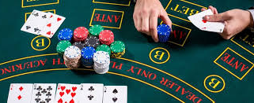
Introduction
Lotteries and casinos rely on this law every day to ensure that, even if gamblers win once or twice, ‘The House’ always wins eventually.
But How do the gamblers win the games?

Slide 11
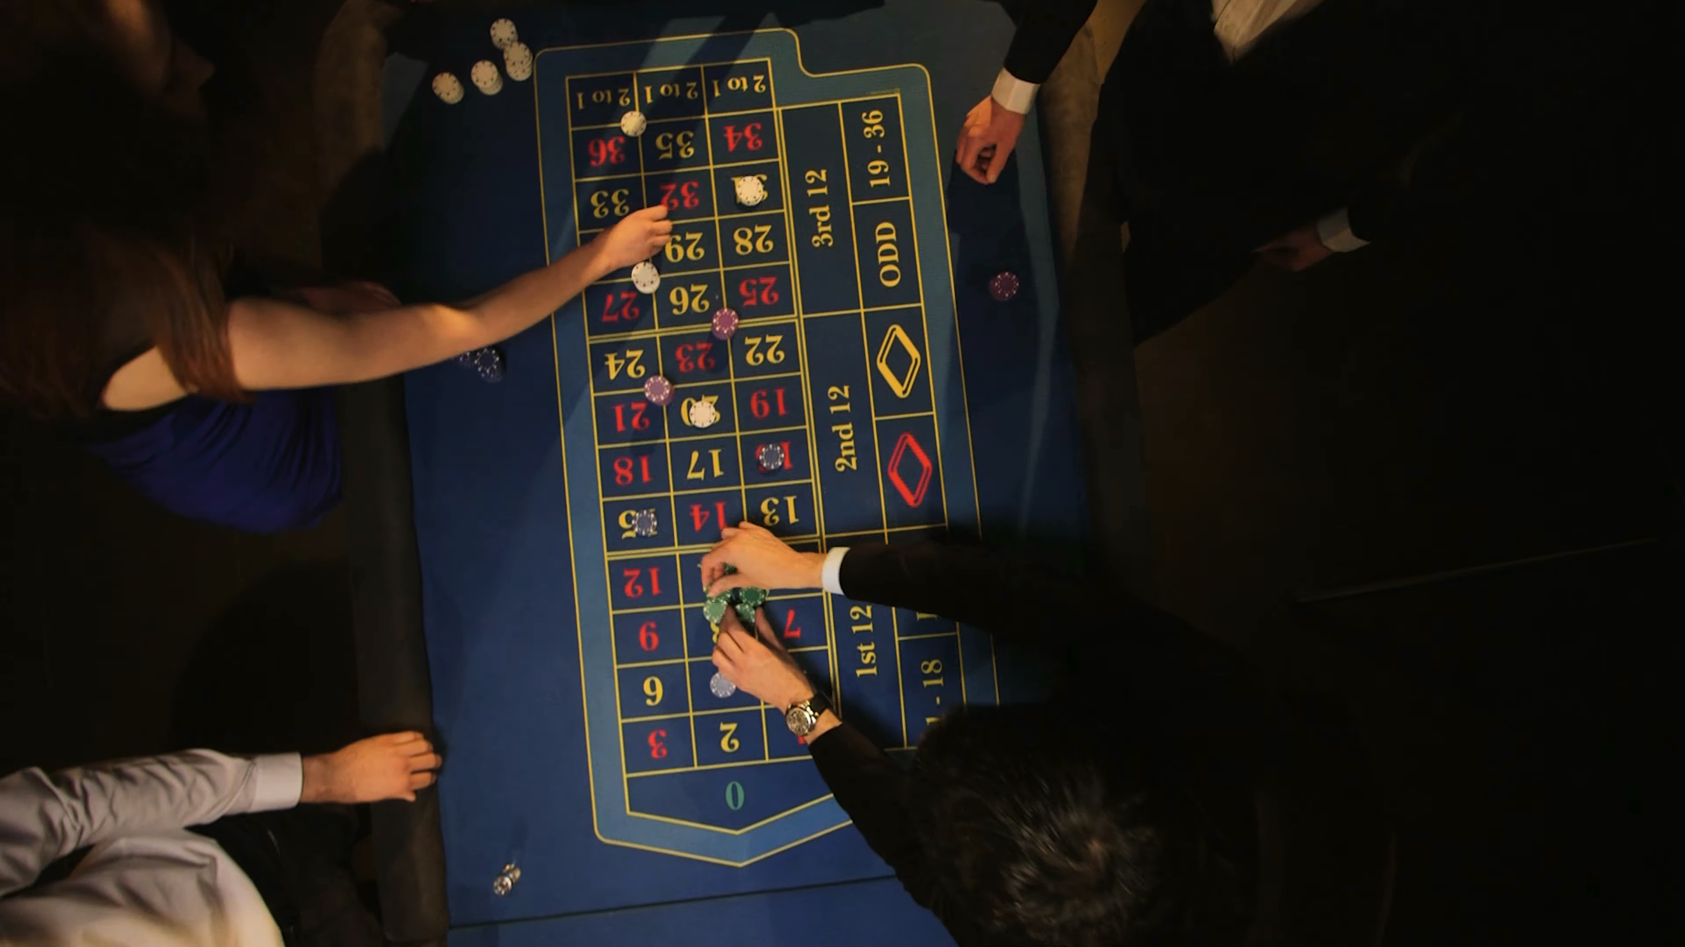

Introduction
For example : roulette is by studying patterns, like the physical movement of the wheel or the deceleration of the ball, and using computers in real time to predict the most likely outcomes.
In doing so, they shift the probabilities in the law of large numbers to make winning more likely.(which makes casinos to modifications its games to their games remain consistently unpredictable.)

Slide 12
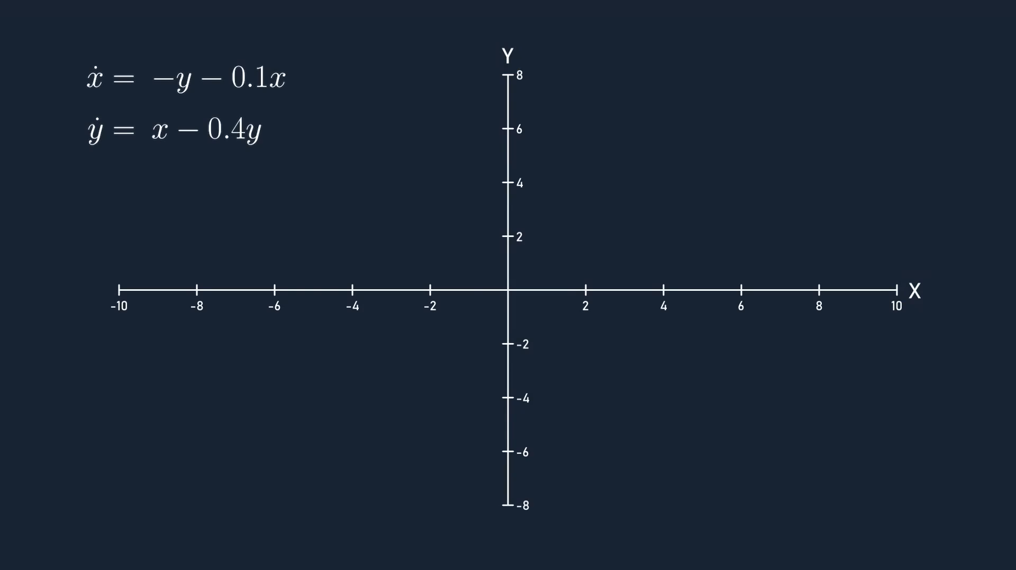
Dynamical Systems
A Dynamical System involves one or more variables that change over time according to autonomous differential equations.

Slide 13
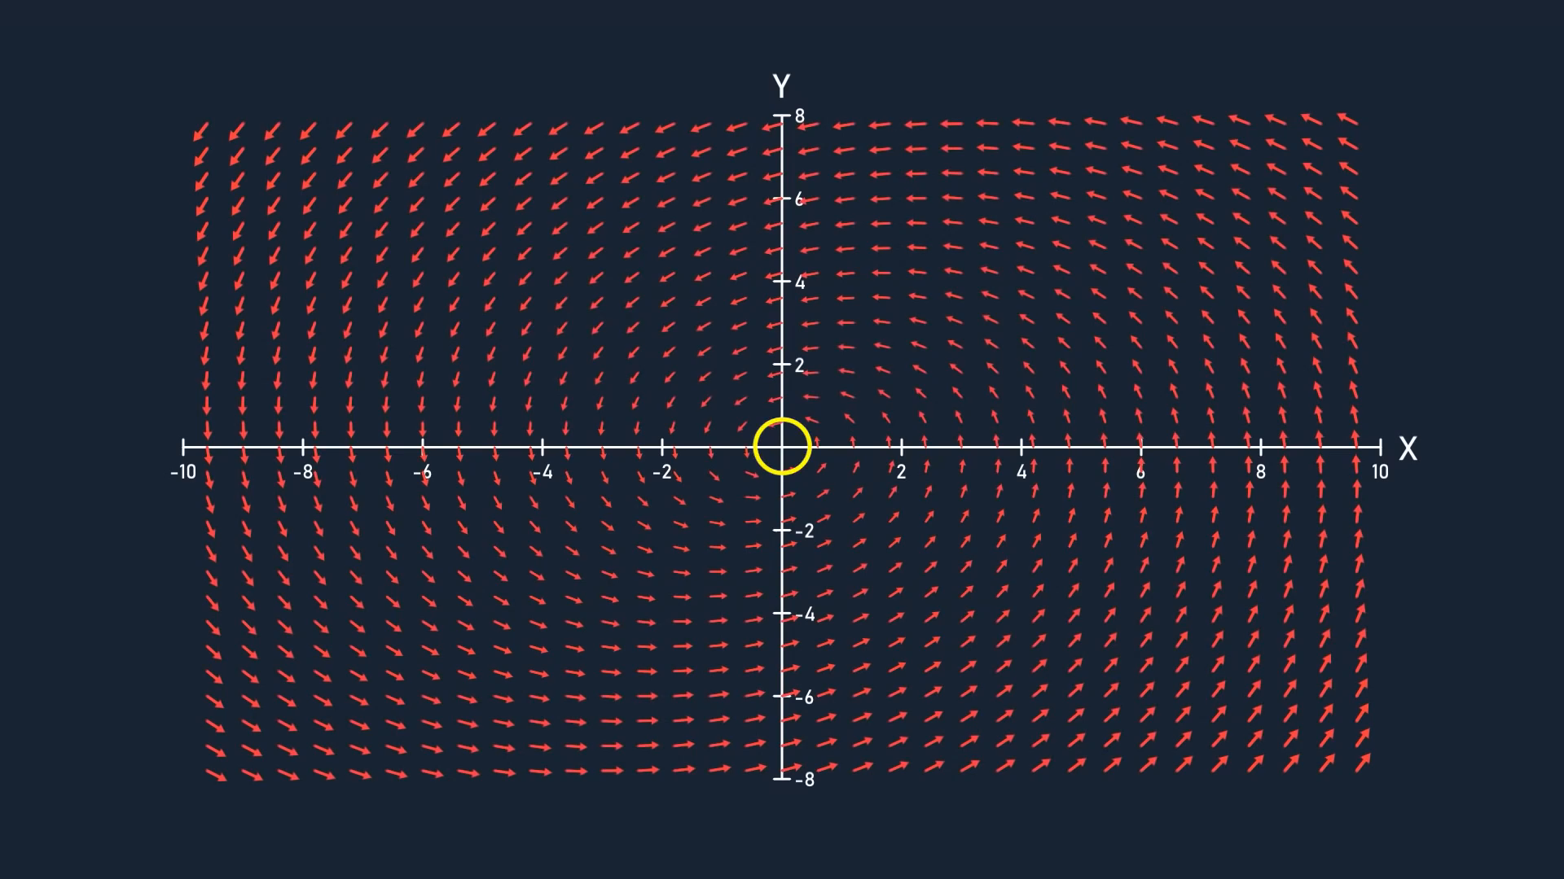
Attractors
An attractor is a set of points in the phase space which attracts all the trajectories in a certain area surrounding it, known as the basin of attraction.
In this example: the attractor is just the origin

Slide 14
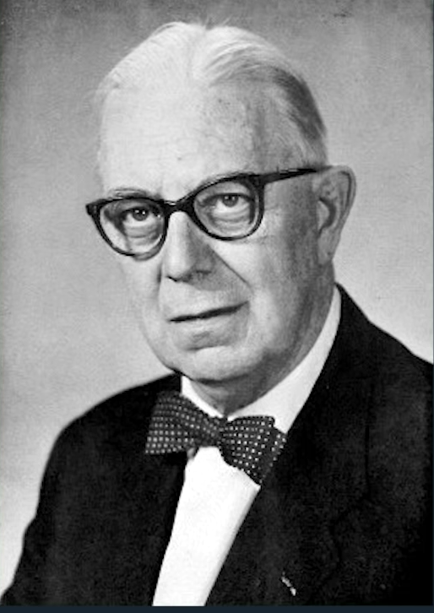
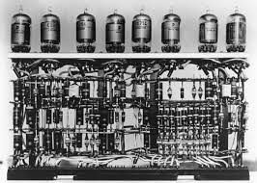
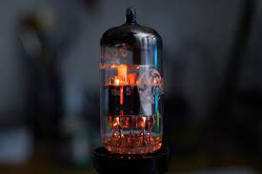
Attractors
But what is chaos?
Balthasar van der Pol worked as an electrical engineer at Philips during the 1920s, and it was while studying vacuum tubes that he stumbled upon a system of differential equations that exhibited some interesting behavior, and would later be known as the Van der Pol oscillator.

Slide 15

Attractors
The Dynamic System he worked on is $\left\{\begin{aligned}\dot{x}=μ(x−\frac{1}{3}x^{3}−y) \\ \dot{y}=\frac{1}{μ}x\end{aligned}\right.$
If we assume $μ$=1 for making it simpler
We have:
$$\left\{\begin{aligned}\dot{x}=x−\frac{1}{3}x^{3}−y \\ \dot{y}=x\end{aligned}\right.$$

Slide 16
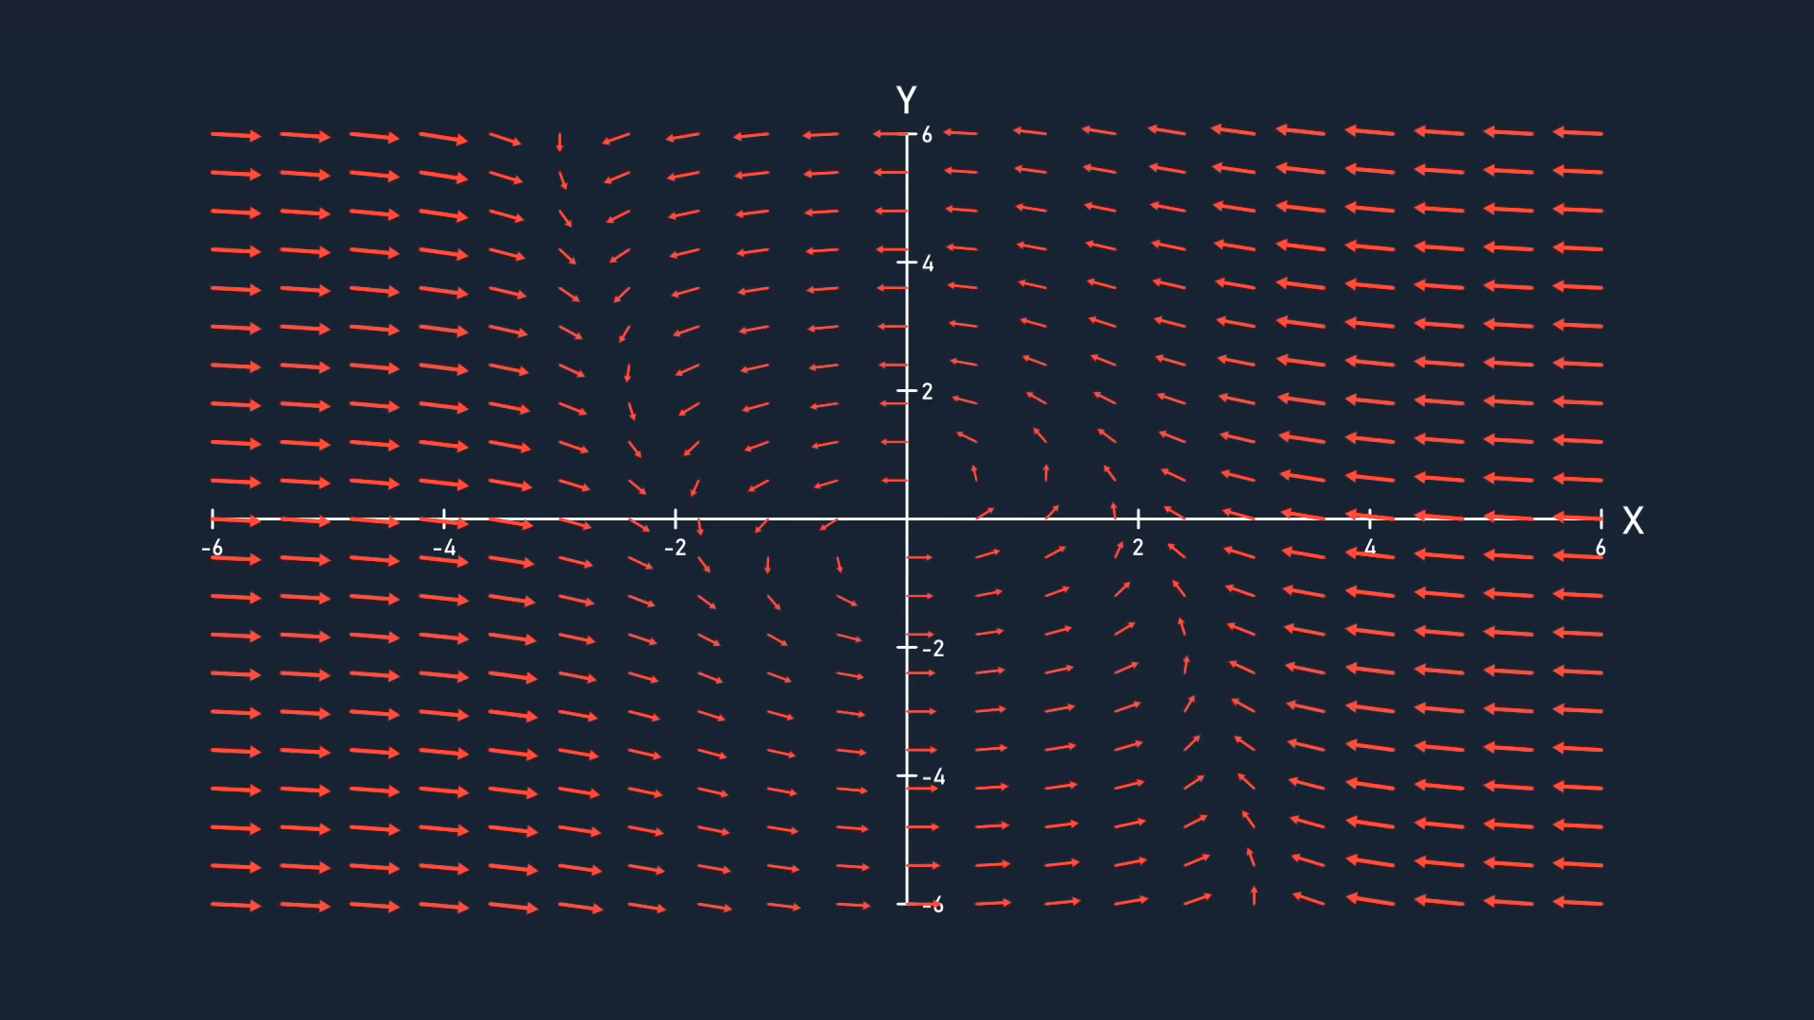

Slide 17
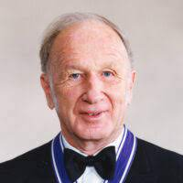
Lorenz Attractor
In 1963, meteorologist Edward Lorenz was developing a simulation for atmospheric conditions which involved 12 changing variables, and found out that tiny differences in the initial values resulted in disproportionately big differences in the state of the variables just a short time after.

Slide 18

Lorenz Attractor
Curious about this, Lorenz spent some time simplifying his simulation to only have 3 variables, but still display this sensitive dependence on initial conditions.
This simplified model describes convection cycles in the atmosphere, and is now known as the Lorenz System.
$$\left\{\begin{aligned}\dot{x}= σ(y−x) \\ \dot{y}=x\left(ρ−z\right)−y \\ \dot{z}=xy − βz\end{aligned}\right.$$
The Lorenz equations have a few parameters that can be tweaked to alter the behavior of the system, but we’ll be using values of 28, 10 and 8/3. $\left\{\begin{aligned}\dot{x}=28(y−x) \\ \dot{y}=x\left(10−z\right)−y \\ \dot{z}=xy −\frac{8}{3}z\end{aligned}\right.$

Slide 19
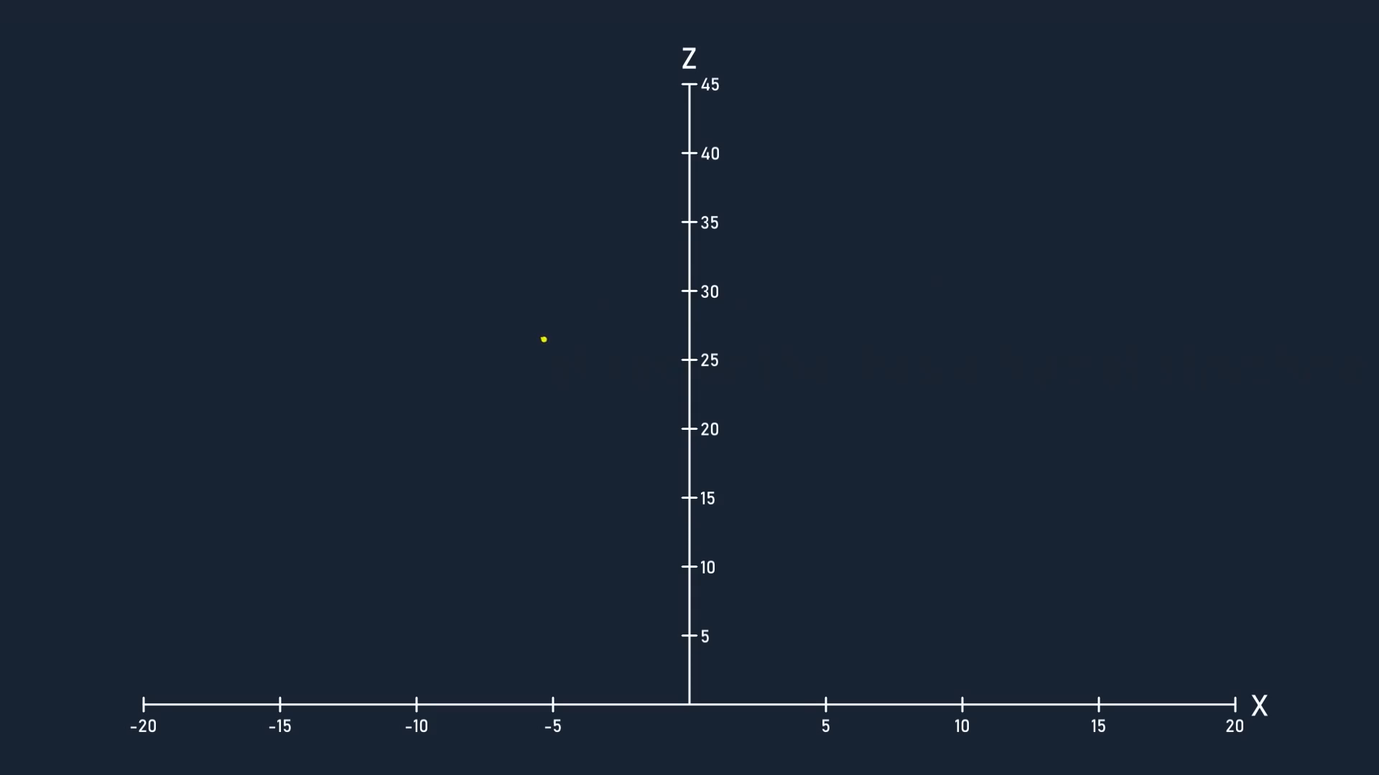
Strange Attractor
A strange attractor is one that has a fractal structure. No point in the space is ever visited more than once by the same trajectory – if that happened, the trajectory would travel in a predictable loop.

Slide 20
Strange Attractor
Observation:
Non integer dimension(about 2.06)
Detail at arbitrarily small scales
Conclusion : Lorenz Attractor is a fractal space and hence a strange attractor.

Slide 21
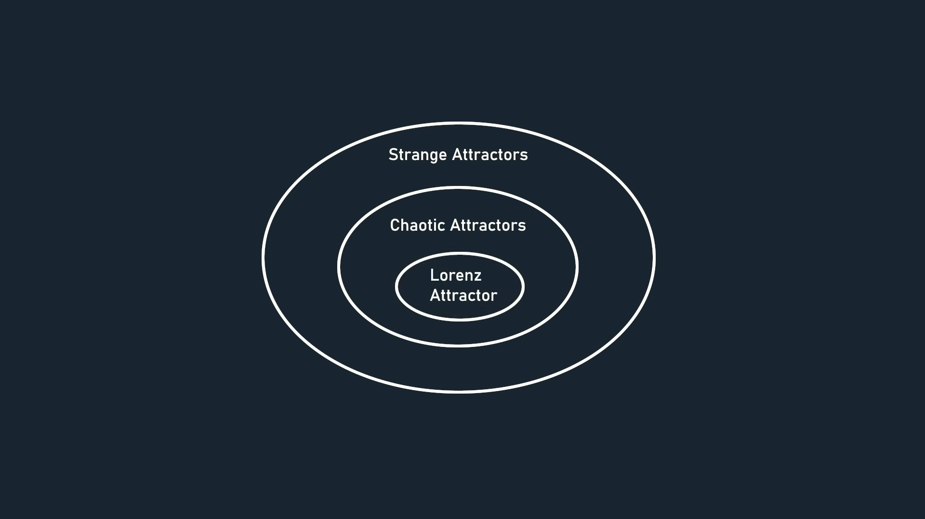
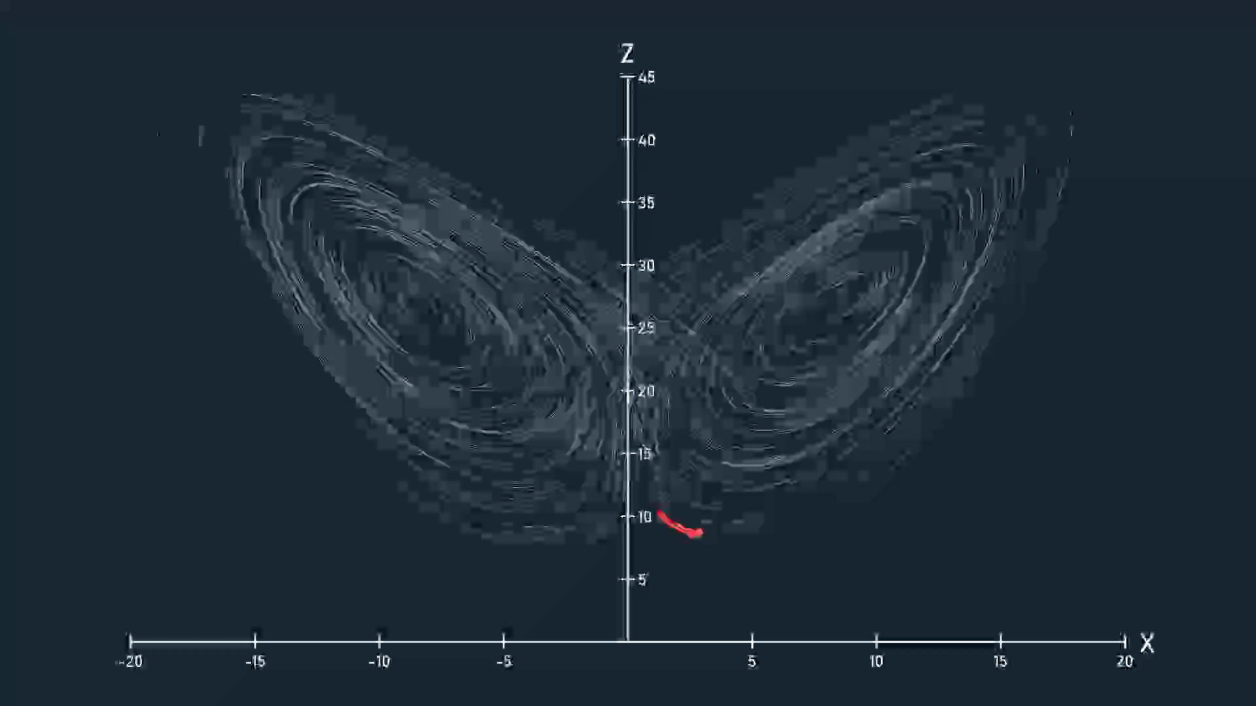
Chaotic Attractor

Slide 22

chaotic Attractor
What is chaotic attractor?
$$d_{t}=d_{0}e^{λt}$$
$$d_{t}=differene at time t$$
$$d_{0}=differene at time 0$$
If have 3 situation
$λ$>0 so the error is rising so that attractor is chaotic.
$λ=0$ so the error distance will stay constant.
$λ<0$ so the error will converge to zero.
For Lorenz $λ$ is about 0.9
That’s how we can figure out the duration of time in which predictions are valid, otherwise known as the predictability horizon.

Slide 23


Slide 24
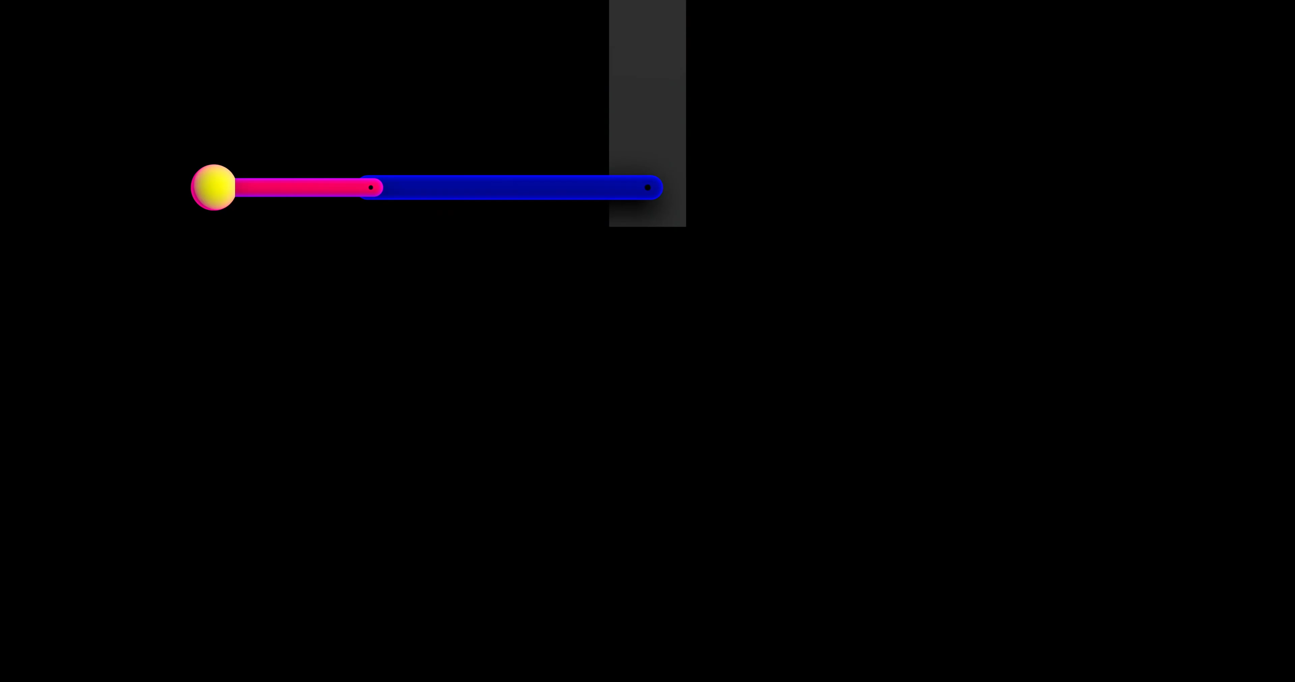

Slide 25

Applications
Business $\left\{\begin{aligned}Growth \\ Stability \\ Income\end{aligned}\right.$
Employee $\left\{\begin{aligned}Mentality \\ Psychology \\ Work rate\end{aligned}\right.$
Customers$\left\{\begin{aligned}Customer Satisfaction \\ Customer feedback\end{aligned}\right.$
Stockholders$\left\{\begin{aligned}Business Network \\ Business Expansion\end{aligned}\right.$

Slide 26
Applications
The weather : Can you predict weather of the next year?
The stock market : Can you predict exchange rates?
Biology :Can you predict how a virus is going to spread?
Physics: Can you predict the motion of gas in vacuum?
Evolution of life: small changes in the chemistry of the early Earth gives rise to life.

Slide 27
Applications
Psychology: A small psychological fact in childhood can lead to problems or suicide in adolescence.
Time travel: he butterfly effect theory presents scenarios involving time travel with "what if" scenarios. This fact attracts Hollywood which is always searching for basis to build stories.

Slide 28
Applications
Highway traffic Jams : Unpredictable and very complex system.
Fractals : Even art has been touched with the chaos theory
Aviation safety:

Slide 29
Quotes Inspired from the theory
You can stay at home and be happily introspective or you can make the choice, step out, and be the Butterfly that begins the tempest that changes the world. (John Sanford)
Sometimes it's the smallest decisions that can change your life forever. (Keri Russell)
Everything we do affects other people.

Slide 30
Movies:

Slide 31
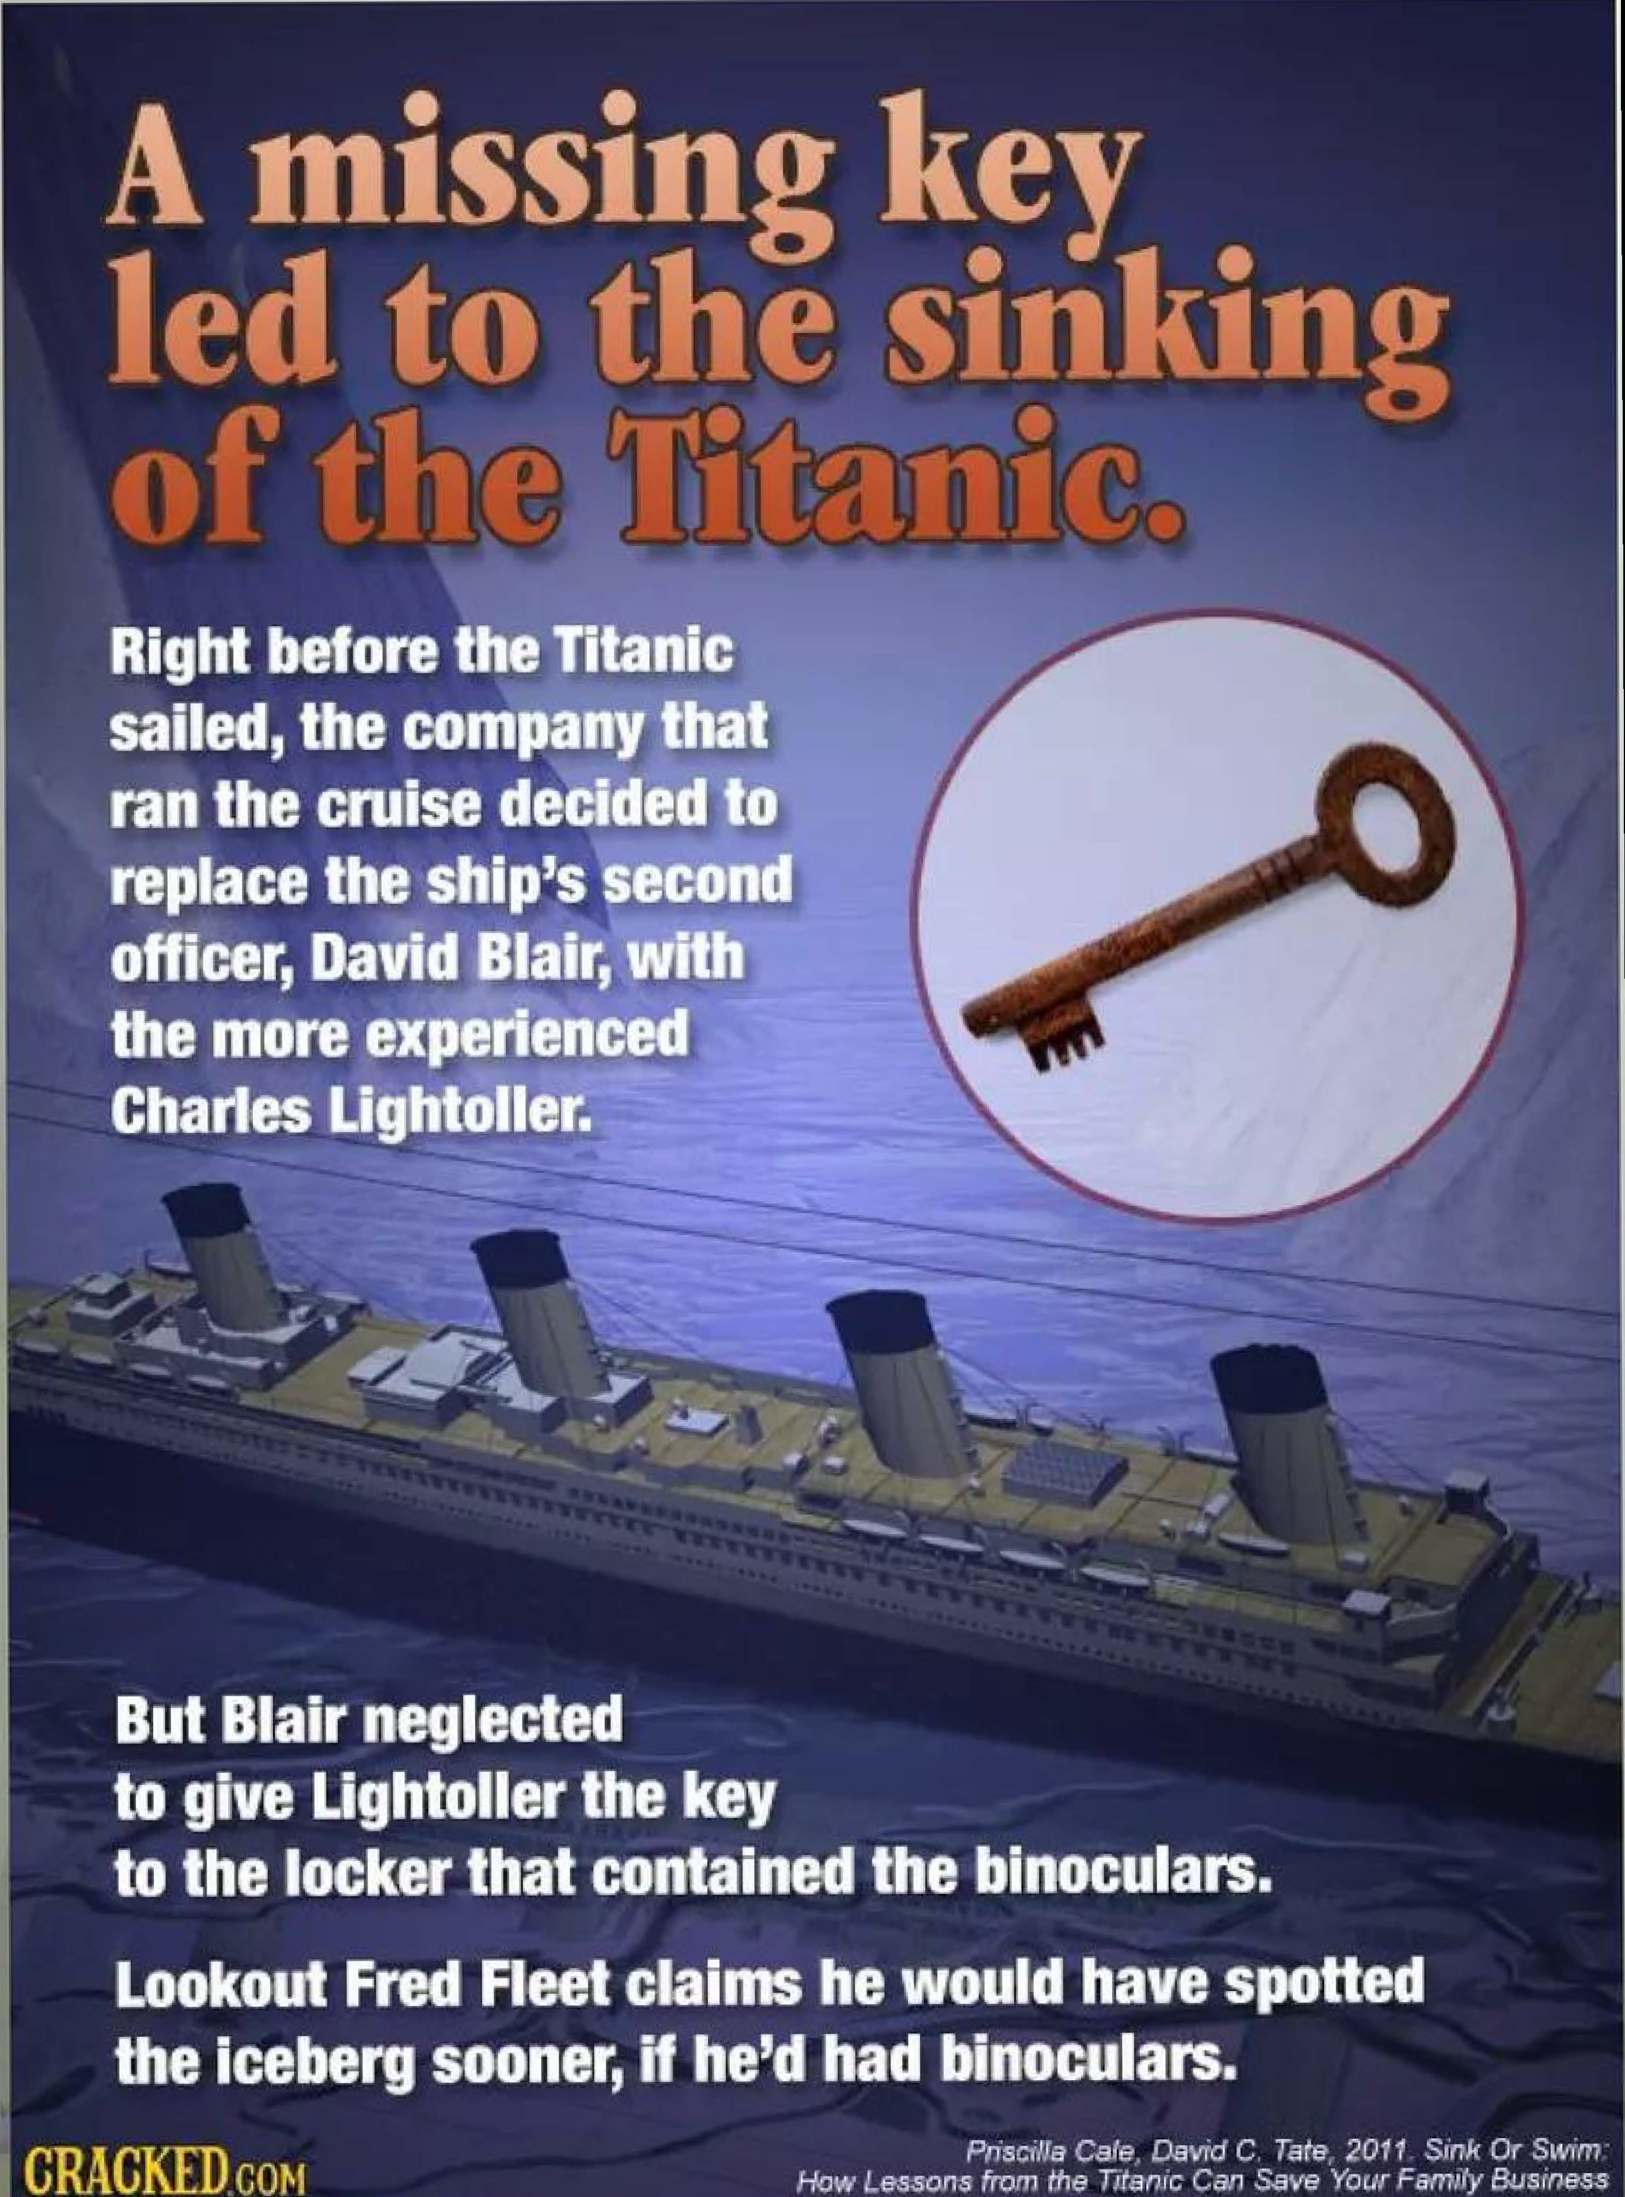
Magazine:

Slide 32
Thanks for your attention !!!
M.Mashreghi

